Slide 1
Streaming Crypto Currency Data & Sentiment Analysis (NLP)

Slide 2
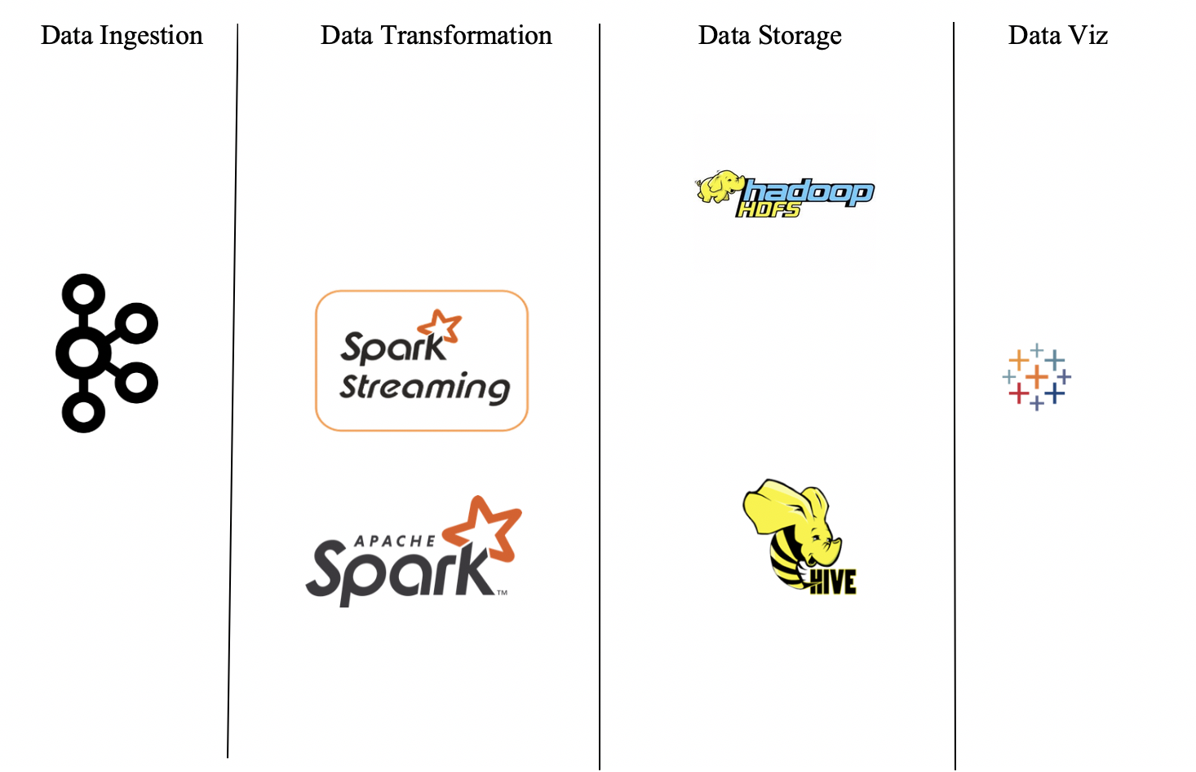
Architecture:

Slide 3

1. Kafka is used as a data ingestion tool. 2. The key role played by Kafka is to transfer data from API to the data transformation layer. 3. A single node and single broker Kafka cluster has been used to transfer the data.
Data Ingestion:
Kafka:

Slide 4


1.The data streaming from the ingestion layer is transformed into required format using spark streaming. 2. The Data obtained from this this transformation is stored in Hadoop HDFS. 3. The final schema of the data to be analysed is decided here in spark streaming. 4. The data is transformed on batches of streams with 2 minutes time frame.
Data Transformation:
Spark Streaming:
Structured Streaming and Spark MLLib:
In structured streaming, The data from Kafka is taken in the form of a data frame.
The Data is processed in batches. Each batch is stored in HDFS .This data is given as an input to spark Mllib to perform sentiment analysis on the news of crypto currency.
A complete Sentiment analysis model has been created to predict sentiment of the news that is being streamed.

Slide 5


1. The data that is transformed is stored in HDFS which is used for further visualization. 2. The data is stored in the form batches in HDFS. 3. These all parts are used when a hive table is formed with these HDFS files.
Data Storage:
Hadoop HDFS:
Apache Hive:
External Hive tables are created on top the HDFS files.
These tables have fixed schema which is used further to import data for visualization.
Complete Data finally forms Hive Tables which are used for data visualization.

Slide 6
https://www.youtube.com/watch?v=rvOXbZbmD5M&feature=youtu.be
Demo:

Slide 7

NLP Using Spark MLlib:
DataPipeline:
Tokenizer
Remover
ngrams
Count Vectorizer
Inverse Document Frequency
Assembler
Indexer
Selector
Logistic Regression
Sentiments

Slide 8
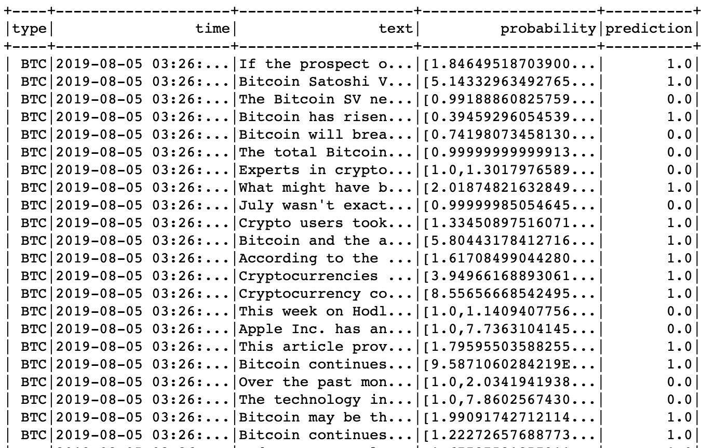
NLP Using Spark MLlib:
The Complete data pipeline developed in the above architecture is loaded.
The model is saved to a variable which predicts the values of the text and saves it to predicted_nlp.csv

Slide 9
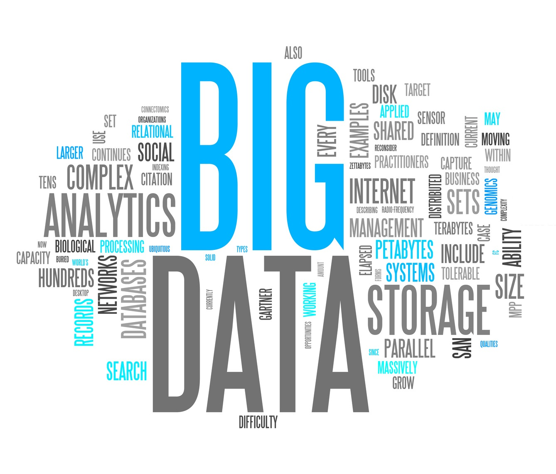
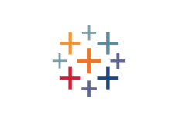
1. The Data from Hive tables is used as an input for tableau for data visualization. 2. Hive connectors where used on tableau to connect the tableau with the hive tables that are developed. 3. The graphs and dashboards where developed to visualize the data from hive tables. INSIGHTS: 1. We found that crypto currency is almost behaving same as stock prices where it is ending peak at closing hours(17 hour of a day). 2.We also found ETH value is changing according to news but BTC value is not changing according to news articles. https://public.tableau.com/profile/meghashyam1279#!/vizhome/Book1_15651277227950/Dashboard1
Data Visualization:
Tableau:

Slide 10
1) Working on RDD’s is a challenge. 2) Spark 2.3.0 doesn’t support Pyspark code to run any ML algorithms you have to write code in Scala. 3)Working with Tableau with Hive connection (Resource Issue) 4) Found Difficulty to execute ML code in Zeppelin (Resource Issue)
Challenges:

Slide 11

Thank you

